Slide 1

CIRCATHON 2025
Dogoše Circular Construction Center

Slide 2






Our Team
Mihael Brlečić
Head of KROG Marketplace
(Currently Bachelor degree student
in informatics and economy at FOI, CRO)
Aditi Vishwas Takale
Head of Computer Vision
(Currently Master degree student
in Computational Engg at FAU, GER)
Andrea Bisciotti, Ph.D.
Team Leader
(Currently Research Fellow
at University of Ferrara, ITA)

Slide 3
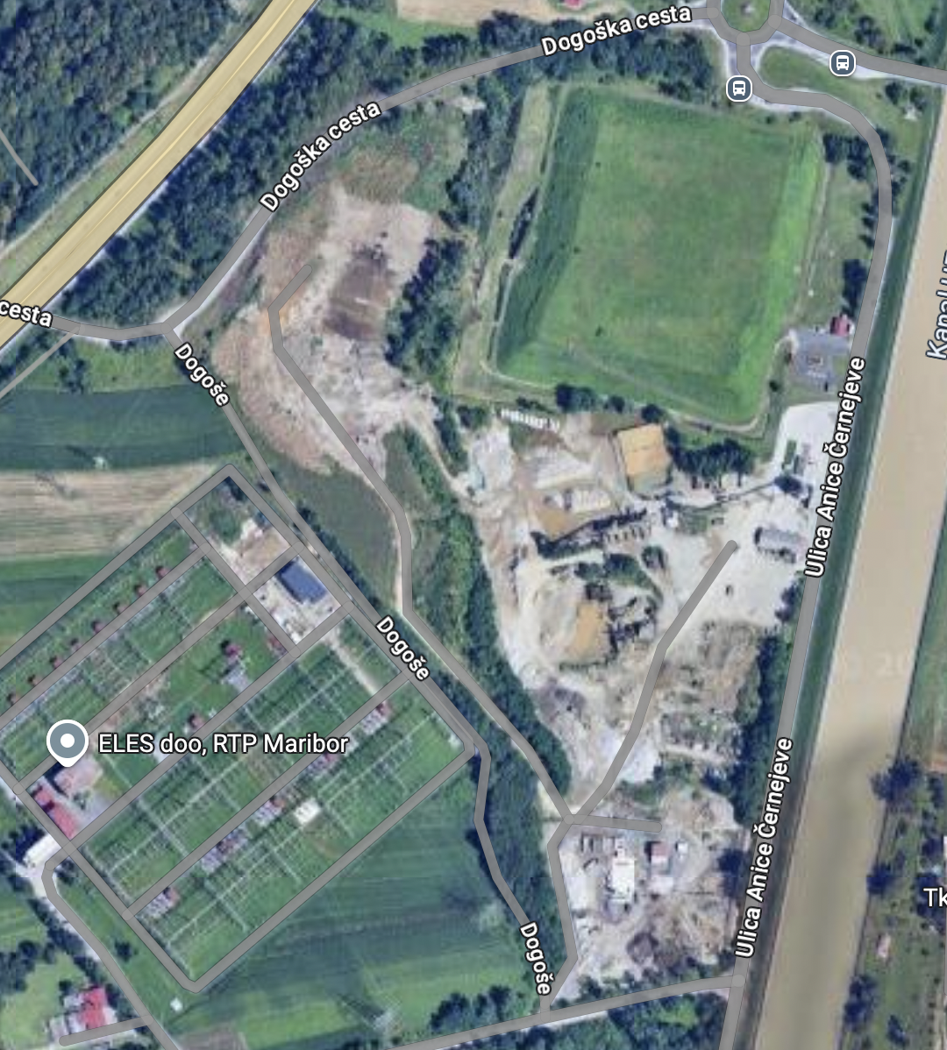
Dogoše Circular Construction Center
(our vision)
Boost of the Waste Plant with the introduction of:
Conveyor belt for primary screening of Waste
COST: 10,000€ *
RGB Optical Cameras on top of the Conveyor belt for in-line (real time) image analysis.
COST: each cameras 1.500€ (x 4)
Dogoše Plant Softwate Manager (DCWP ®) by KROG group.
COST OF DEVELOPING (12 months): 50.000€
New Slovenian National Online Marketplace for recycled materials (KROG marketplace ®) COST OF DEVELOPING (24 months): 40.000€

Slide 4
The time-line
2 years
Conveyor belt + RGB cameras (6 months)
Waste Images Database (3 months)
Machine Learning Training (3 months)
Software testing (6 months)
PILOT PLANT
KROG
Marketplace

Slide 5
RGB waste recognition
For this classification, the model is trained with over 200 images for each class:
Concrete, Bricks and ceramics, Wood, Plastics, Glass, Metals.
*Images are taken from different angles and lighting conditions.
Then for each recognized material, the AI draws a virtual outline around it in the image to isolate it from the background.
We then quantify the material volume from the images.
Volume is calculated by combining the information from the depth sensor with the 2D area (outline of the material).
This data is then used to automatically sort materials, track recycling amounts, or flag hazardous items—all without manual measurement.

Slide 6
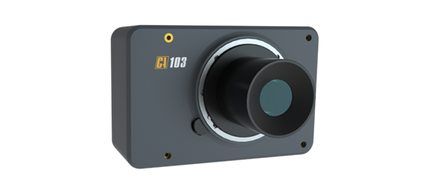
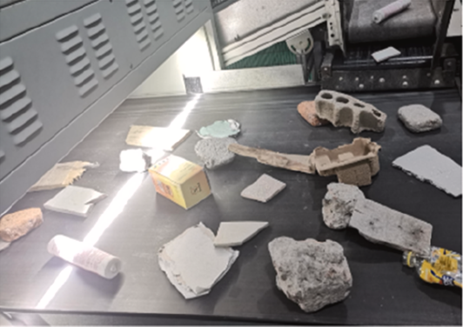
RGB
Camera
Machine Learning classification
Volume and Type
Conveyor belt
Real-time
monitoring
Plant Manager Software (DCWB)
Slovenian
Stakeholder
Marketplace
Platform

Slide 7
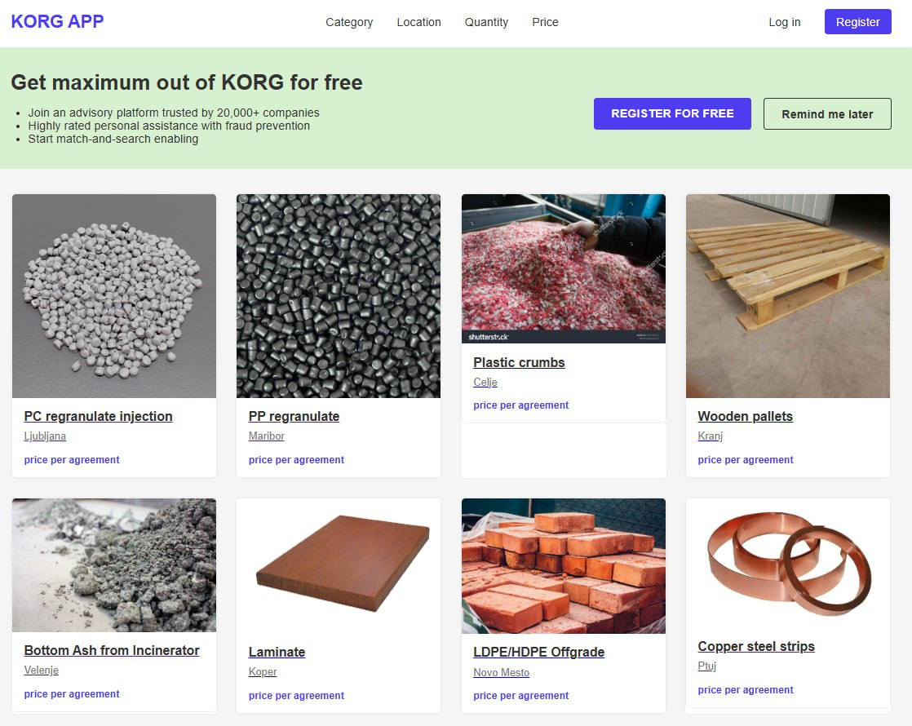
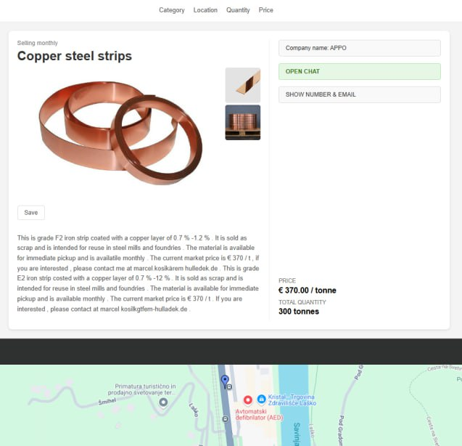
The KROG Slovenian Marketplace
Online website and phone app (geolocalized)

Slide 8
The Slovenian stakeholders
Based on Artificial Intelligence, the KROG marketplace associates the recycled materials produced (DCWB software) with potential final reuse practice.
The Marketplace notifies to the subscribed community: persons, companies and local entities (administration, municipalities) in Slovenia the availability and possible applications for recycled material produced based on artificial intelligence:
Architectural Structures - Wood and Metals based application in the production of timbers and other structural elements for housing.
Artisanal Manufactures - (wood, metals) for public spaces and private home furniture.
Arts and performances - application in the field of liberal arts and performance.

Slide 9
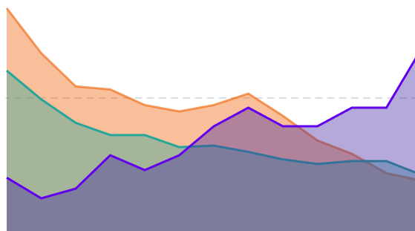
CONCLUSIONS
RGB
Camera
Analysis of waste collected
Online marketplace platform
The tailored Marketplace helps the local community getting more involved in the circular practice.
OUR REVENUES: Software licence (DCWB) and Marketplace fees

